Slide 1

Instaplanner
Kelly Huynh
Samanvitha Basole
Aaron Escoto
Tri Ninh
CS 174 - Final Project
December 2015

Slide 2
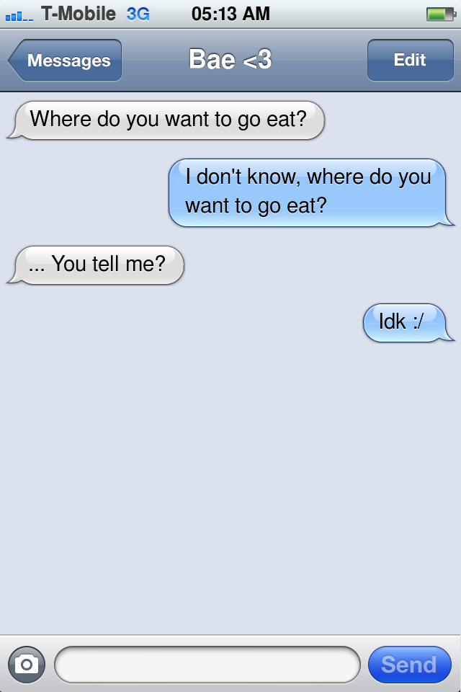
Problem
You’re out on a date and not sure what to do

Slide 3
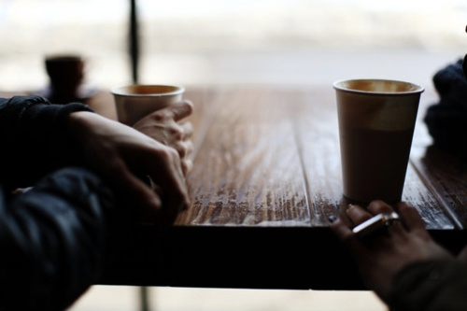
Solution
Develop a random date ideas generator

Slide 4
Demo

Slide 5
Step 1: Prototype

Slide 6
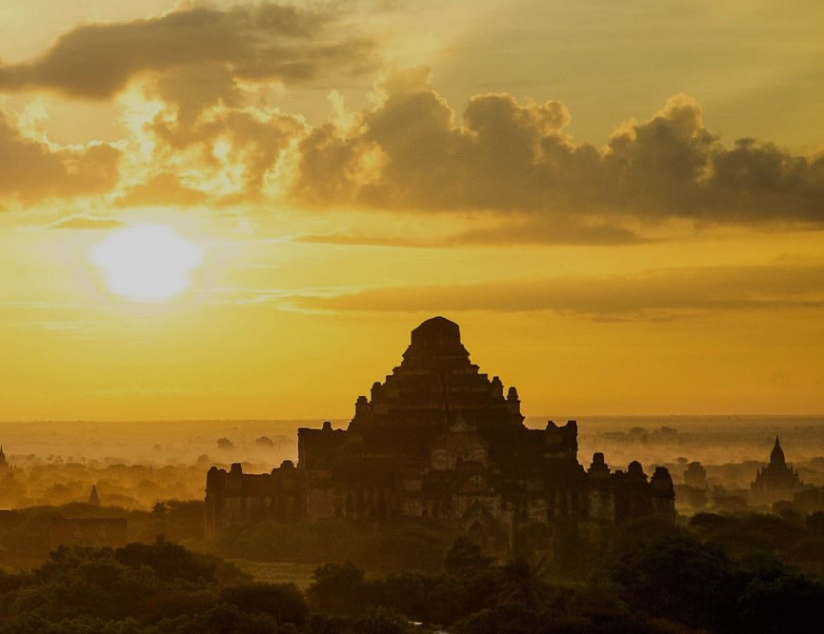
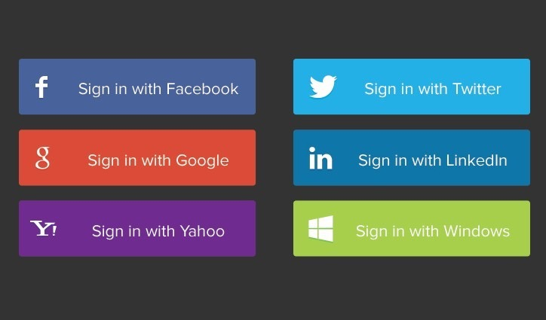
Perfect Day
Your Perfect Day
Let’s get started, Kelly
Or create an account

Slide 7

What are your favorite things to do?
Travel
Food
Couples
Art
Learning
Music
Sports
Local

Slide 8
What are your favorite things to do?
Travel
Food
Couples
Art
Learning
Music
Sports
Local

Slide 9
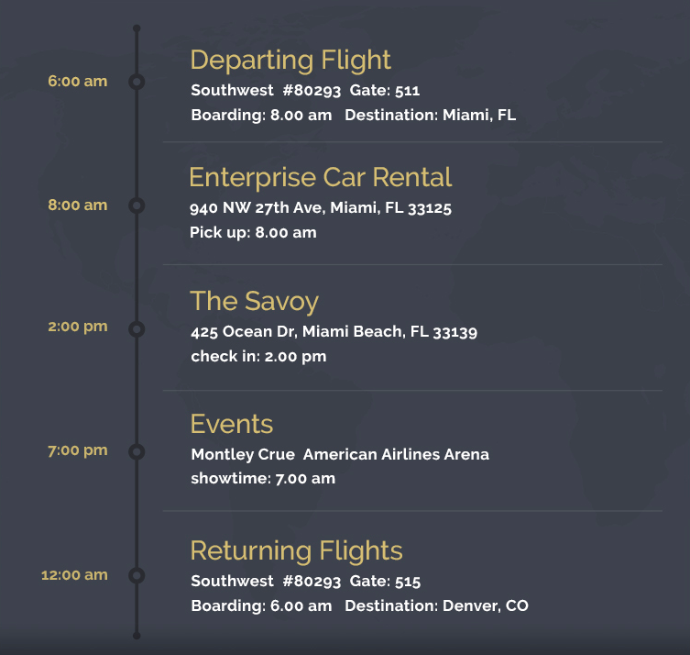
Hi Kelly, here’s your perfect day
Your Perfect Day

Slide 10
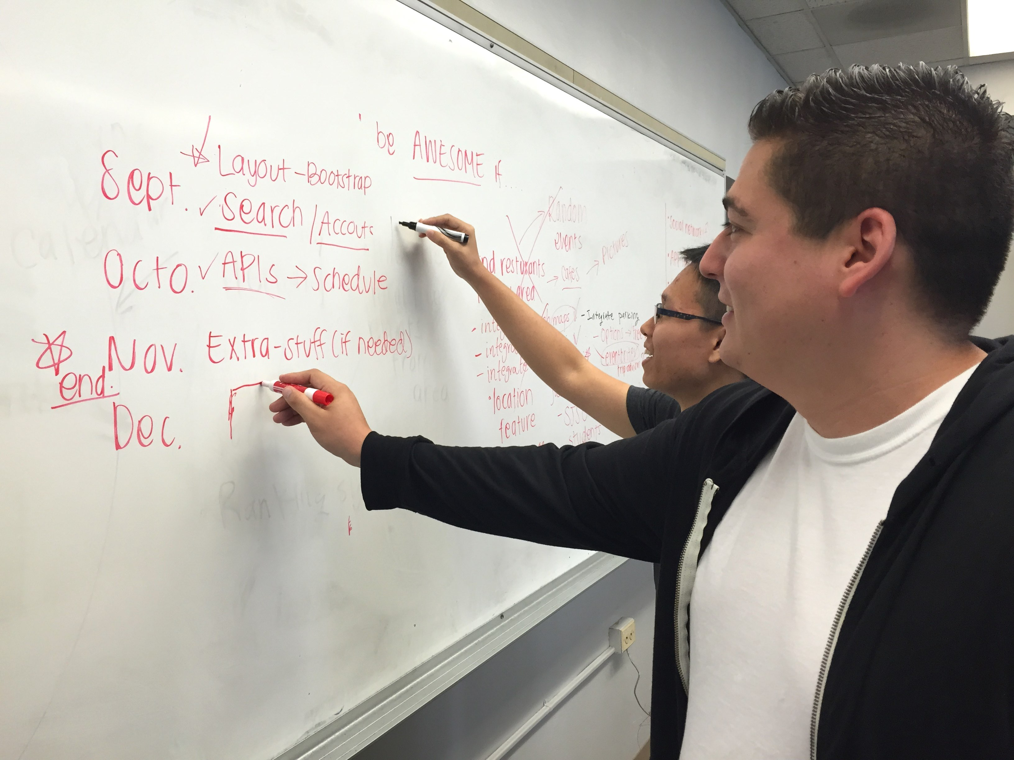

Slide 11


Kelly
User Experience
Front-End Development

Slide 12
Aaron - talk about what you added to the web app

Slide 13
Samanvitha - talk about what you added to the web app

Slide 14
Tri - talk about what you added to the web app

Slide 15
What did we learn?
Our new favorite and sings about web development and JavaScript
JSON Derulo

